Slide 1


Applied Machine Learning
A Case Study Approach
Fahad Sarfraz

Slide 2

INTRODUCTION
Fahad Sarfraz
Software Engineer at Arbisoft, Machine Learning Department
A Machine Learning Engineer and a Data enthusiast with professional experience in employing machine learning algorithms and tools for image classification, text analytics and financial data prediction
Contact:
Email id: fahad.sarfraz@outlook.com | Tel: +92-341-4400551
LinkedIn: https://www.linkedin.com/in/fahadsarfraz/ | Github: https://github.com/fahad92virgo/

Slide 3
Applied vs Theoretical Machine Learning
Applied Machine Learning is about understanding the Machine Learning concepts at an abstract level sufficient enough to solve problems using machine learning. This involves gaining expertise in using the tools and libraries which implement the Machine Learning Algorithms at their core.
Theoretical Machine Learning on the other hand is about understanding the underlying algorithms, mathematics, probability theory, statistics and definitely a lot of other subjects/concepts at the fundamental level.
Advice: Aim to strike a balance between the two.

Slide 4


Applied vs Theoretical Machine Learning cont..
Theoretical Machine Learning
Applied Machine Learning
Applied machine learning is about solving real world problems.
This is where the potential and impact of new inventions/discoveries made through advancements in theoretical machine learning are realized.

Slide 5
Why the Case Study Approach
Build an intuitive sense of the core concepts
Gain a strong understanding of the machine learning pipeline
Get motivation to dive deeper
Solve real world problems

Slide 6
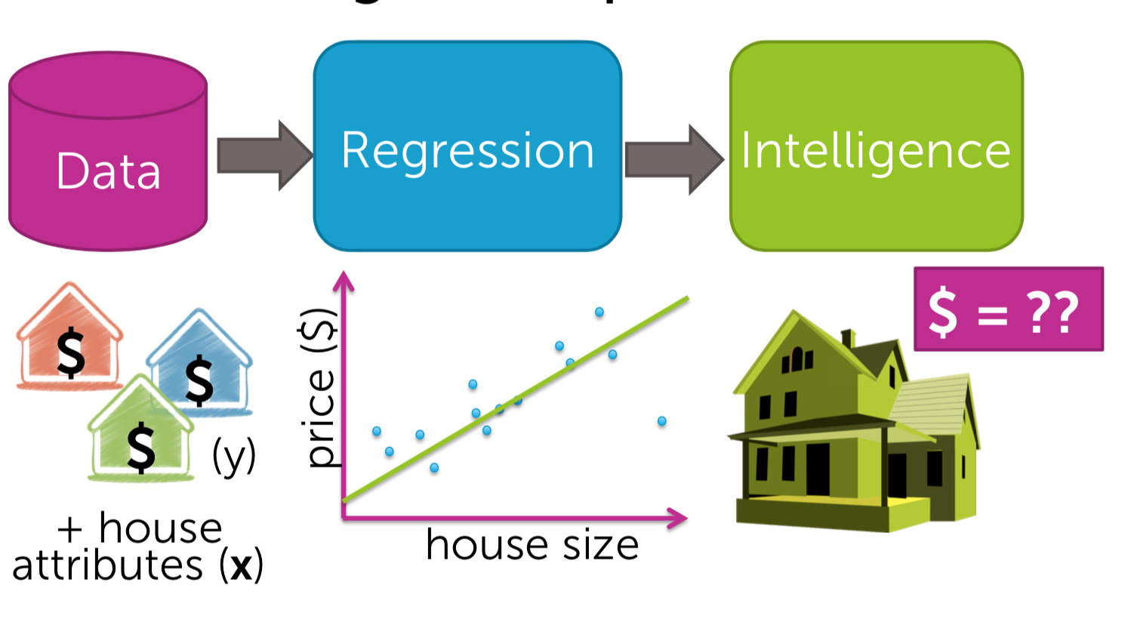
Case Study: Predicting House Prices

Slide 7
Core Steps
Exploratory Analysis
Data Cleaning
Feature Engineering
Algorithm Selection
Model Training
1
2
3
4
5

Slide 8
Exploratory Analysis
The purpose of exploratory analysis is to "get to know" the dataset.
Objective:
gain valuable hints for Data Cleaning
think of ideas for Feature Engineering
get a "feel" for the dataset
Guidelines:
Distributions of numeric features: plot distributions to identify outliers, binary features, potential measurement error
Distributions of categorical features: Use bar charts to look out for sparse classes
Segmentations: use box plots to observe the relationship between categorical features and numeric features
Correlations: look at the relationships between numeric features and other numeric features.

Slide 9
Data Cleaning
Key Takeaway: ‘Better data beats fancier algorithms.’
Unwanted observations: remove duplicates or irrelevant observations
Structural errors: fix typos, inconsistent capitalization, mislabeled classes,
Outliers: Outliers can cause problems with certain types of models. you must have a good reason for removing an outlier, such as suspicious measurements that are unlikely to be real data.
Missing data: you cannot simply ignore missing values in your dataset. You must handle them in some way for the very practical reason that most algorithms do not accept missing values
Dropping missing values is sub-optimal because when you drop observations, you drop information.
Imputing values is suboptimal because you are not adding any real information. You’re just reinforcing the patterns already provided by other features.
Always tell your algorithm that a value was missing because missingness is informative
for categorical features is to simply label them as ’Missing’!
For missing numeric data, you should flag and fill the values.

Slide 10
Feature Engineering
“Applied machine learning” is basically feature engineering.” - Andrew Ng
Feature engineering is about creating new input features from our existing ones.
Feature Engineering allows us to:
isolate and highlight key information, which helps your algorithms "focus" on what’s important.
bring in our own domain expertise.
Guidelines:
Interaction features: combinations of two or more features.
Sparse Classes: group sparse classes together that have very few total observations.
Dummy Variables: Most machine learning algorithms cannot directly handle categorical features.
remove unused or redundant features from the dataset.

Slide 11
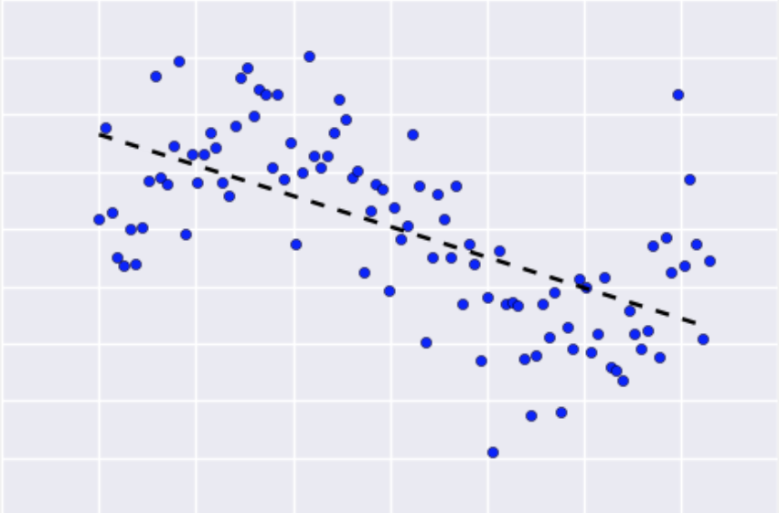
Algorithm Selection
Linear Regression
Simple linear regression models fit a "straight line”, or more precisely a a hyperplane depending on the number of features.
Their main advantage is that they are easy to interpret and understand
However, simple linear regression suffers from two major flaws:
It's prone to overfit with many input features.
It cannot easily express non-linear relationships.

Slide 12
Algorithm Selection cont..
Regularization:
Regularization is a technique used to prevent overfitting by artificially penalizing model coefficients
It can discourage large coefficients (by dampening them).
It can also remove features entirely (by setting their coefficients to 0).
The "strength" of the penalty is tunable
Lasso Regression
Penalizes the absolute size of coefficients
Practically this leads to coefficients that can be exactly 0
Ridge Regression
Penalizes the squared size of coefficients
Offers automatic feature selection because it can completely remove some features
Practically this leads to smaller coefficients but it doesn't force them to 0
Offers feature shrinkage

Slide 13
Model Training
Split dataset: Training sets are used to fit and tune your models. Test sets are put aside as "unseen" data to evaluate your models
Comparing test vs. training performance allows us to avoid overfitting... If the model performs very well on the training data but poorly on the test data, then it’s overfit.
Parameter Tuning: There are two types of parameters in machine learning algorithms.
Model parameters are learned attributes that define individual models. They can be learned directly from the training data
Hyperparameters express "higher-level" structural settings for algorithms. They are decided before fitting the model because they can't be learned from the data

Slide 14
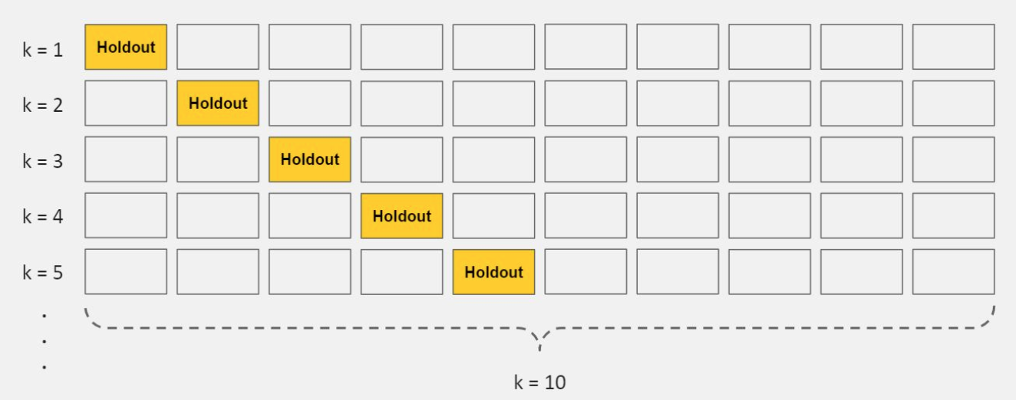
Model Training cont.
Cross-validation
Cross-validation is a method for getting a reliable estimate of model performance using only our training data.
There are several ways to cross-validate. The most common one, 10-fold cross-validation, breaks your training data into 10 equal parts (a.k.a. folds), essentially creating 10 miniature train/test splits.
Steps for 10-fold cross-validation:
Split your data into 10 equal parts, or "folds".
Train your model on 9 folds (e.g. the first 9 folds).
Evaluate it on the 1 remaining "hold-out" fold.
Perform steps (2) and (3) 10 times, each time holding out a different fold.
Average the performance across all 10 hold-out folds

Slide 15
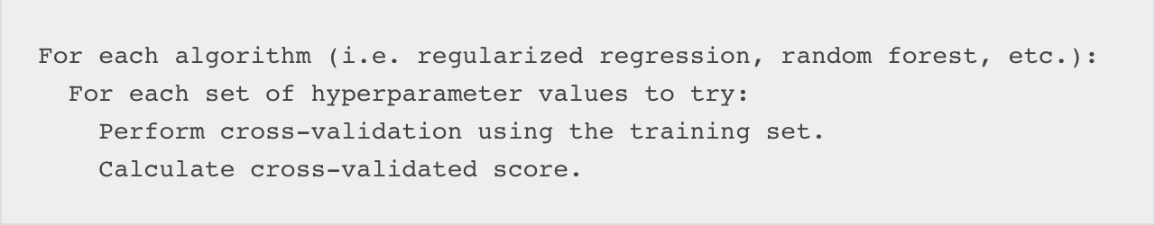
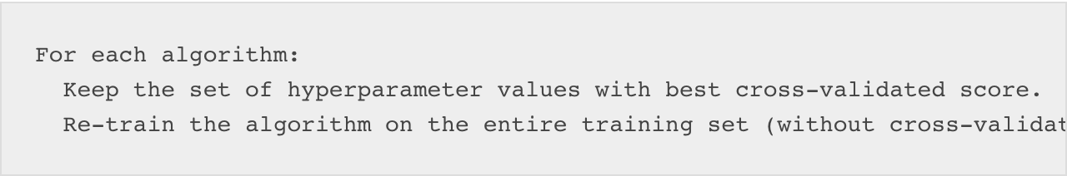
Model Training cont.
Fit and tune models
perform the entire cross-validation loop detailed above on each set of hyperparameter values we'd like to try
we'll pick the best set of hyperparameters within each algorithm.

Slide 16
Model Training cont.
Select winner
Now it’s time to evaluate each model and pick the best one
Because we've saved our test set as a truly unseen dataset, we can now use itto get a reliable estimate of each models' performance
There are a variety of performance metrics you could choose from. We won't spend too much time on them here, but in general Mean Squared Error (MSE) or Mean Absolute Error (MAE) is recommended for regression tasks
For each of your models, make predictions on your test set.
Calculate performance metrics using the predictions and the "ground truth" target variable from the test set

Slide 17
Model Training cont.
Finally, use these questions to help you pick the winning model:
Which model had the best performance on the test set? (performance)
Does it perform well across various performance metrics? (robustness)
Did it also have (one of) the best cross-validated scores from the training set? (consistency)
Does it solve the original business problem? (win condition)

Slide 18
Credits
Elite Data science 7 Days Crash Course. https://elitedatascience.com/
Washington University’s Machine Learning Specialization on Coursera. https://www.coursera.org/specializations/machine-learning

Slide 19
“The key to artificial intelligence has always been the representation.”
— Jeff Hawkins

Slide 20
THANK YOU

